Slide 1
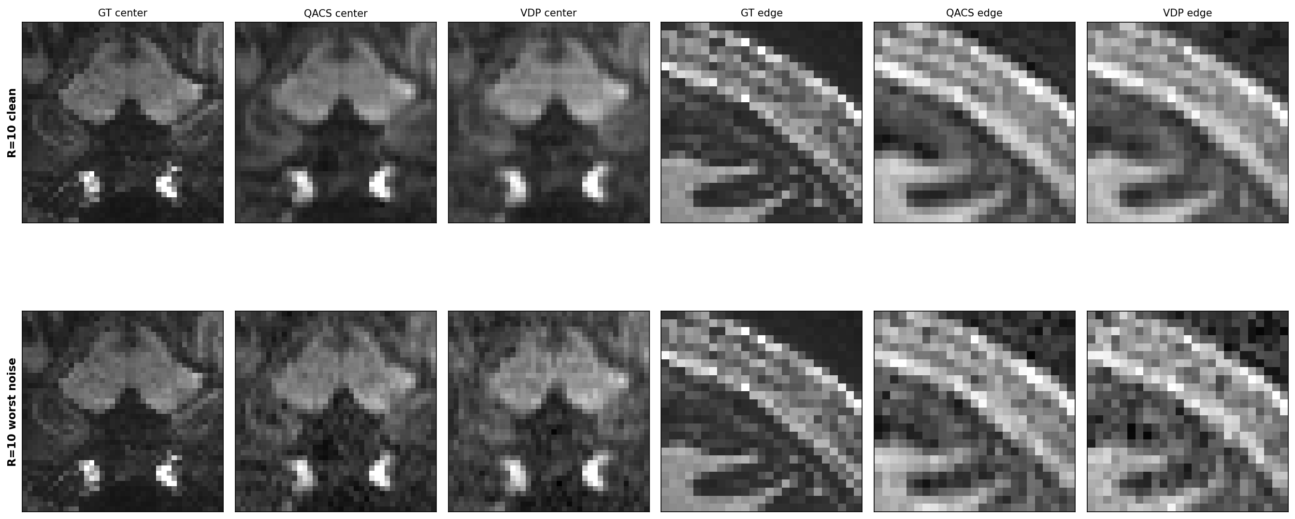
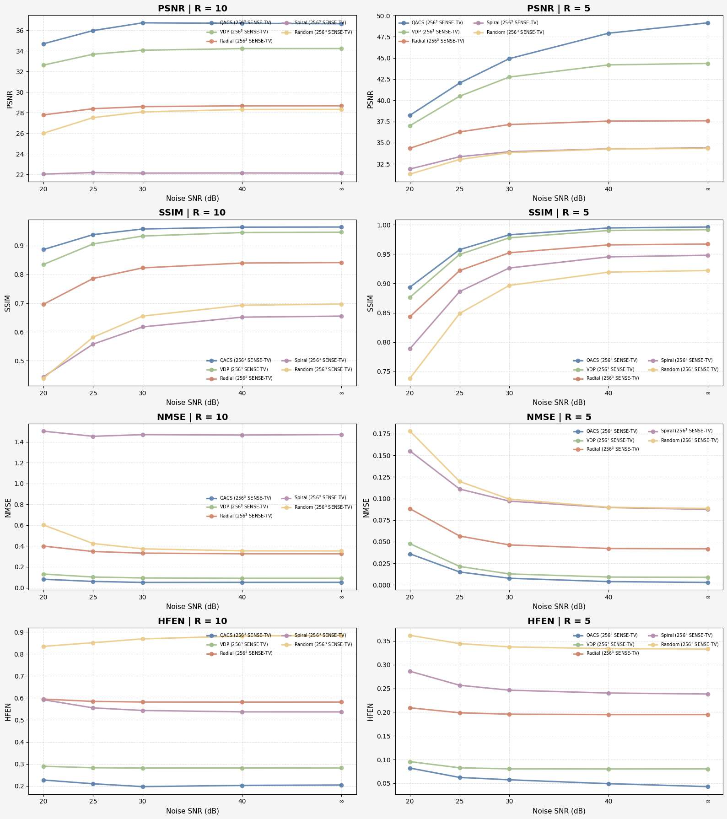
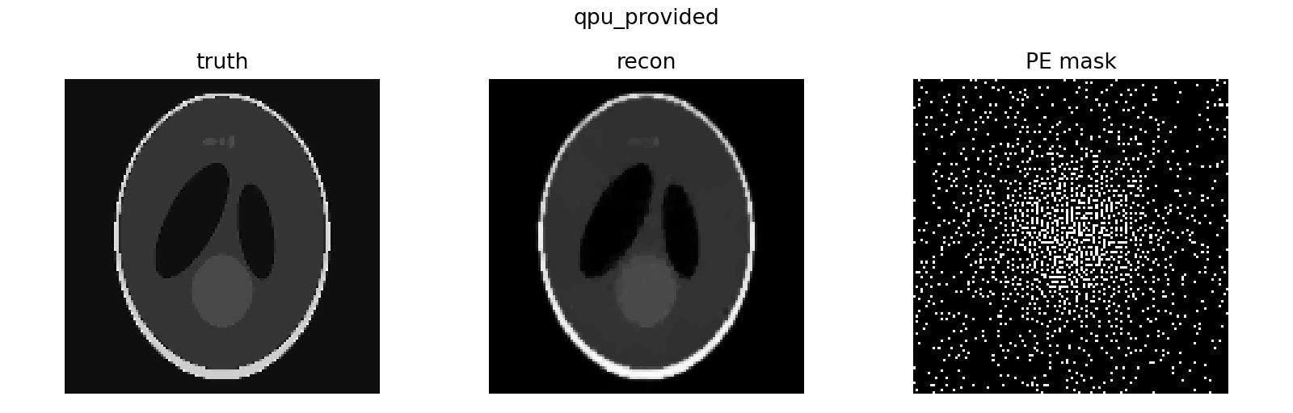
QUANTUM ADAPTIVE SENSING FOR ACCELERATED MRI
Asmit Ganguly · Suprajit Dewanji · Chenyang Zhao · Danny J. J. Wang
arXiv:2607.21737v1 · PREPRINT
Laboratory of Functional MRI Technology · USC Neuroimaging and Informatics Institute
WHY + HOW
RECONSTRUCTION EVIDENCE
WHAT CHANGED
THE PROBLEM
49.03 dB
Static k-space masks cannot react to the signal already measured. Under aggressive acceleration, that can waste scarce phase-encode lines and erase diagnostically useful structure.
PSNR · 20% sampling · 256³
+4.65 dB
THE IDEA
PSNR gain over VDP · 20% sampling
QACS turns each next-batch decision into a fixed-cardinality QUBO. The objective combines a center prior, measured signal energy, and pairwise dispersion—making the mask adaptive and solver-independent.
Local structure: QACS better preserves center and edge detail than VDP, including the worst-noise setting.
65% lower
NMSE vs VDP · 20% sampling
1
Acquire
2
Score QUBO
3
Select
QUANTUM-HARDWARE CHECK
BOTTOM LINE
Adaptive sampling improved image fidelity at both 20% and 10% acquisition budgets—and retained its advantage under noise.
Reduced-pool D-Wave hybrid results were comparable to VDP. This demonstrates feasibility—not quantum advantage.
Noise study · 256³, 8 coils: QACS shows the flattest degradation across reconstruction metrics.
NEXT → prospective scanner validation · raw human multi-coil data · fair end-to-end solver timing
Notes:
Present from left to right: clinical sampling problem, adaptive QUBO loop, qualitative and noise-robustness evidence, headline metrics, then the bounded quantum-hardware claim.
[Sources]
- Ganguly A, Dewanji S, Zhao C, Wang DJJ. Quantum Adaptive Sensing for Accelerated MRI. arXiv:2607.21737v1 (2026). https://arxiv.org/abs/2607.21737
- All three figures reproduced from the supplied author preprint PDF; metrics are reported in its quantitative comparison tables.

